Slide 1

SHYAMA PRASAD MUKHERJEE RURBAN MISSION
(MADHYA PRADESH)
SIMROL CLUSTER
TEHSIL – MHOW
DISTRICT – INDORE

Slide 2
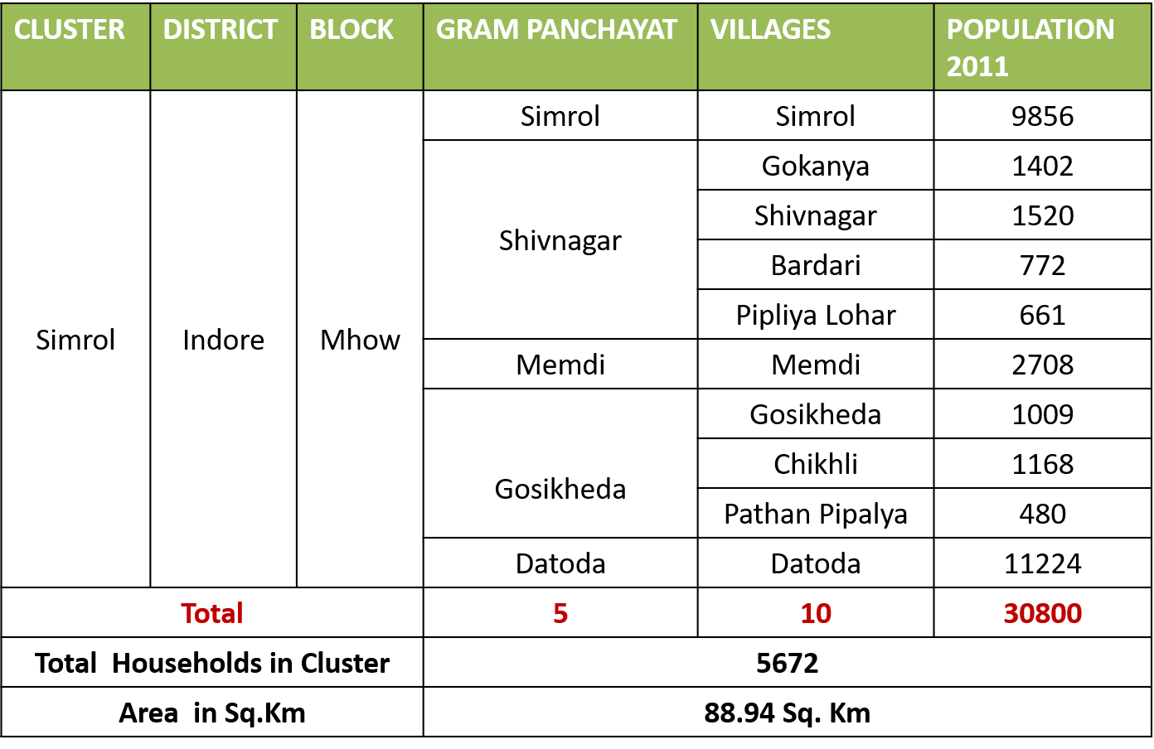
Cluster Profile

Slide 3














Physical & Financial Progress
Upgradation of Schools
24x7 Water Supply
Agri services & Processing
Public Transport
SLWM
2.8 cr
4.15 cr
0.77 cr
9.55 cr
1.5 cr
Health
Skill Development
0.44 cr
1.5 cr
3.2 cr
0.3 cr
2.88 cr
2.3 cr
0.68 cr
Special Social Infrastructure & Tourism
Street Lights & Renewable Energy
Village Street with Drains
Digital Literacy
Citizen Service Centre

Slide 4

PROBLEM SHARING OF SIMROL CLUSTER

Slide 5
Physical & Financial Progress
COMPONENTS | ACTIVITIES | WORKS ON GROUND (IN LAKH)
Upgradation of Schools | Boundary wall -10, Internal Electrification – 3, Smart, Class: 5 , School Building with Shade - 2 ,School, Building – 2, Extra room: 4 | 248.79
Special Social Infrastructure & Tourism | Community Hall- 6, Aanganwadi Boundary wall- 1, Playground - 1 | 110.25
24x7 Drinking water | OHT : 6, ESR : 1, Sumpwell : 6, Electric connection : 7 , Tubewell : 7, Submersible motor pump : 7 , Pump, House : 7 , HH coverage : 1285 HH | 400.91
Public Transport | Bus Shelters: 2 | 8.04
Health | Waiting Hall with toilets -1, Boundary Wall -1,Paver Blocks -1, Rain Water Harvesting -1 | 26.76
CC Roads with drains | CC roads with drains: 14 roads ,Total Length: 6.3 km | 300.16
Village street light | Street Light in 9 Villages | 22.29
Agriculture processing | Horticulture Grading Center, Potato & Onion Processing & Packaging Unit , Milk Processing & Packaging Unit, Warehouse/ Godown/ Silos, Procurement house for perishable item, Stop Dams | 102.01
Citizen Service Centre | Common Service Center | 0.00
Skill Development | Multi purpose Training Hall | 0.00
Digital Literacy | Establishment of Mobile Facilitation Center | 0.00
SLWM | Solid waste management, Liquid Waste Management | 0.00
Total |  | 1219.21

Slide 6
Outcomes Achieved Based on ICAP’s Vision/Gap
Component | ICAP Vision/ Gap | Outcomes Achieved
Upgradation of Schools | Infrastructural development through Boundary Walls, Playgrounds, Dining Hall, Extra Classrooms, Digital Classroom | Construction of Boundary Wall in all schools, Smart Class with Course content, extra rooms, new building, playground
Special Social Infrastructure & Tourism | Community Halls, Eco-tourism center, Land Development, Access road, Landscaping and Beautification, Services. | Construction of 6 Community halls with shops, Anganwadi Boundary wall, playground .
24x7 Drinking water | Infrastructure provision : OHTs, Pumping Facility, Piped water supply and Tube Wells | Piped water supply covering 100% households in 7/10 Villages.
Public Transport | Bus Stand and Bus Shelter for every village. | Construction of 2 bus shelter as per feasibility.
Health | Up gradation of existing Primary and Sub Health Centre | Construction of Boundary wall, Patient Waiting Hall and RWH
CC Roads with drains | Conversion of gravel roads within villages to CC roads with storm water drains. | Construction of 14 Km CC road with drains in all 10 villages unaided by any scheme/grant
Agriculture processing | Stop Dams, Water Recharging, Siphoning of seasonal river, Horticulture , Floriculture and Milk Processing Units. | Construction of Stop Dams, Ground water recharge shafts, revival of Kanad River.

Slide 7
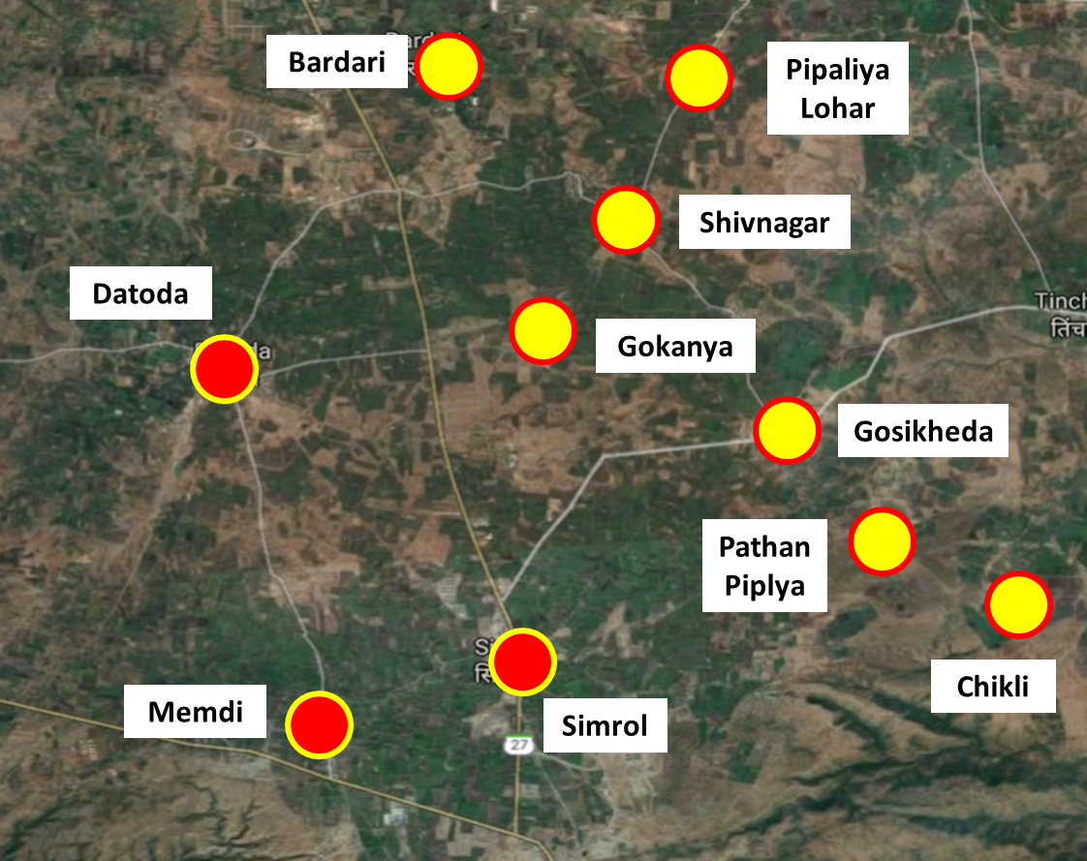
24x7 Piped Water Supply
No of Villages taken | 7/10
No. of HH covered | 1284
Activities taken
Tube well, Narmada Linkage | 12-
Total Pipeline (rm) | 24400
OHTs | 6
ESRs | 1
Total Capacity | 375 KL
Total Amount (Rs) | 401 Lakh
Physical Status | Near Completion

Slide 8
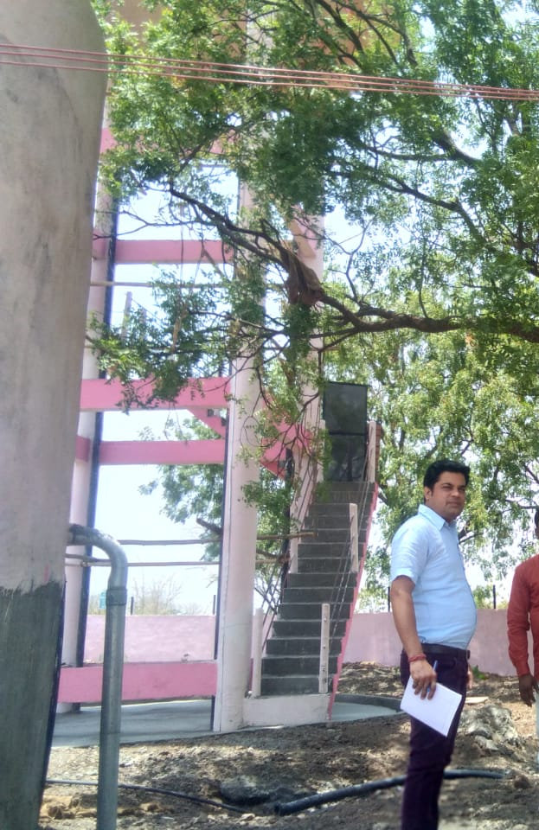
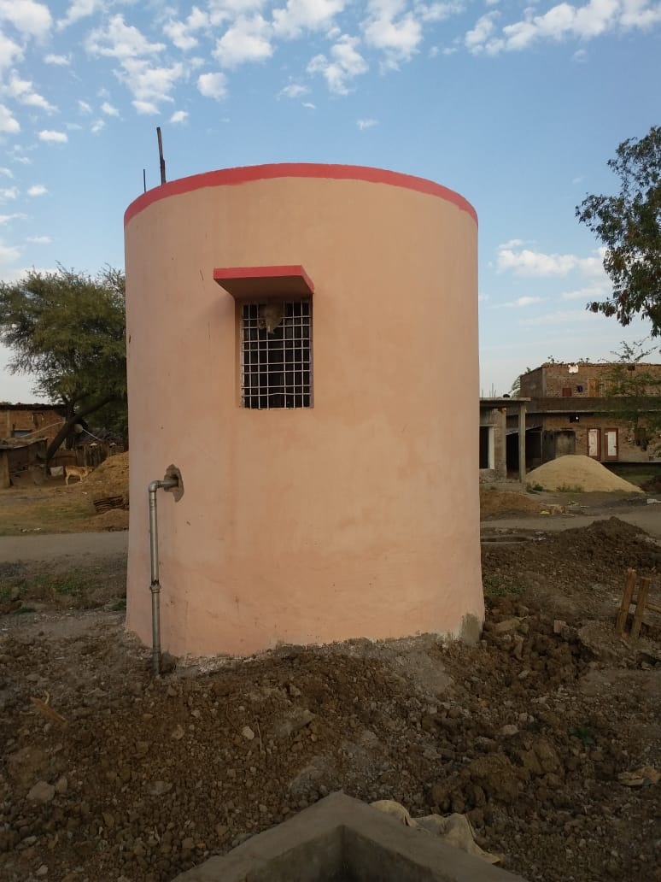
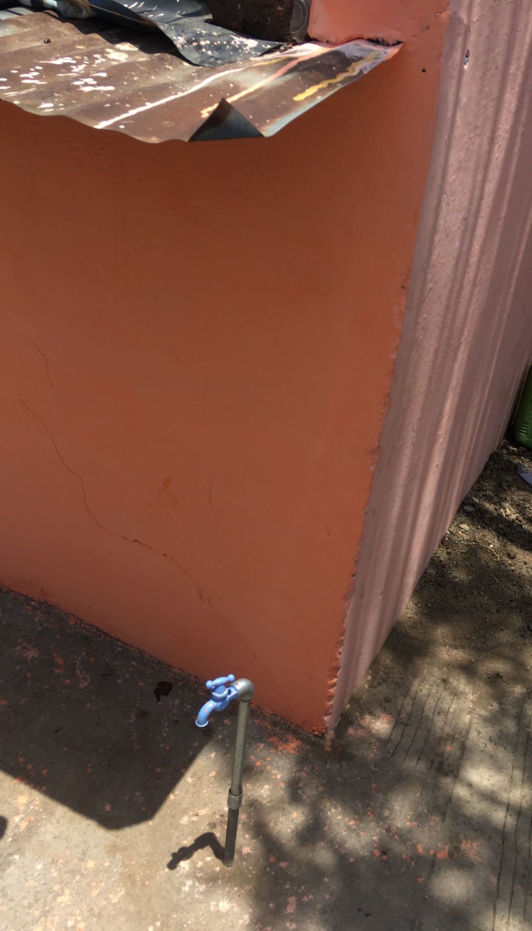
24x7 Piped Water Supply
Over Head Tank
Sump Well & Valve
Household Connection

Slide 9
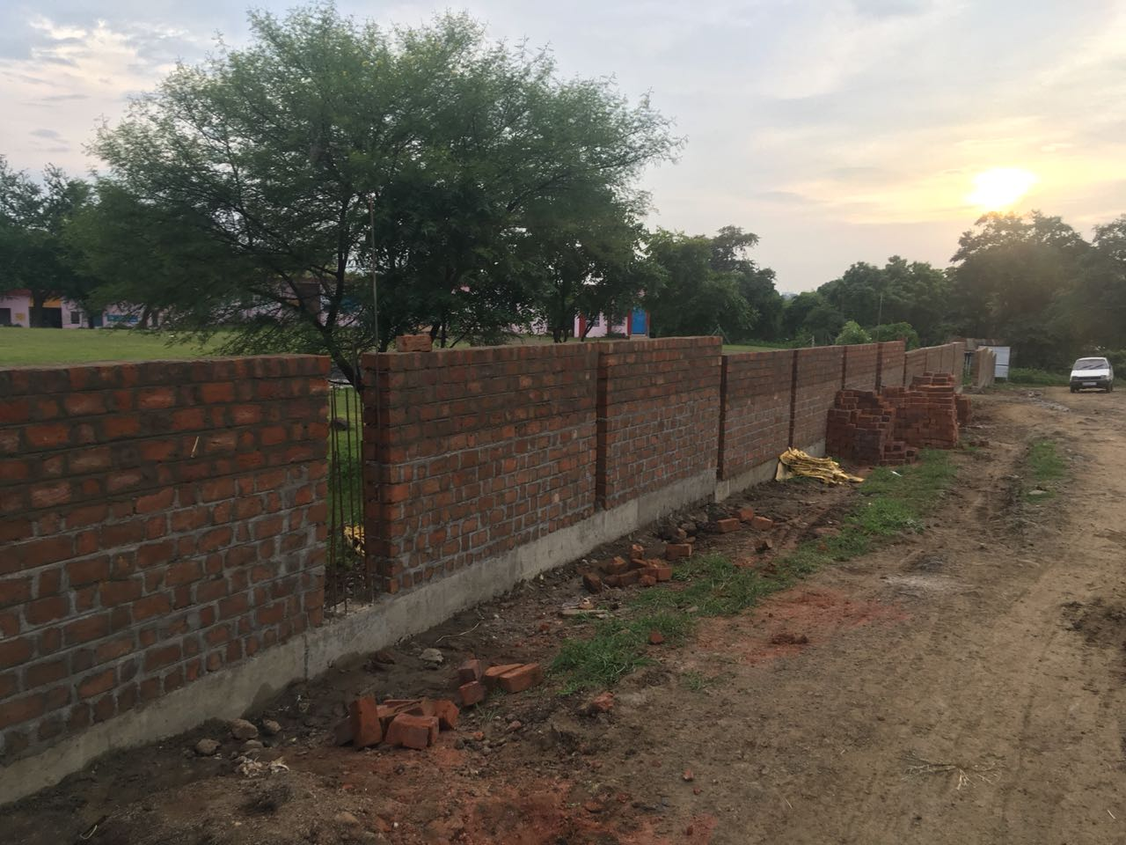
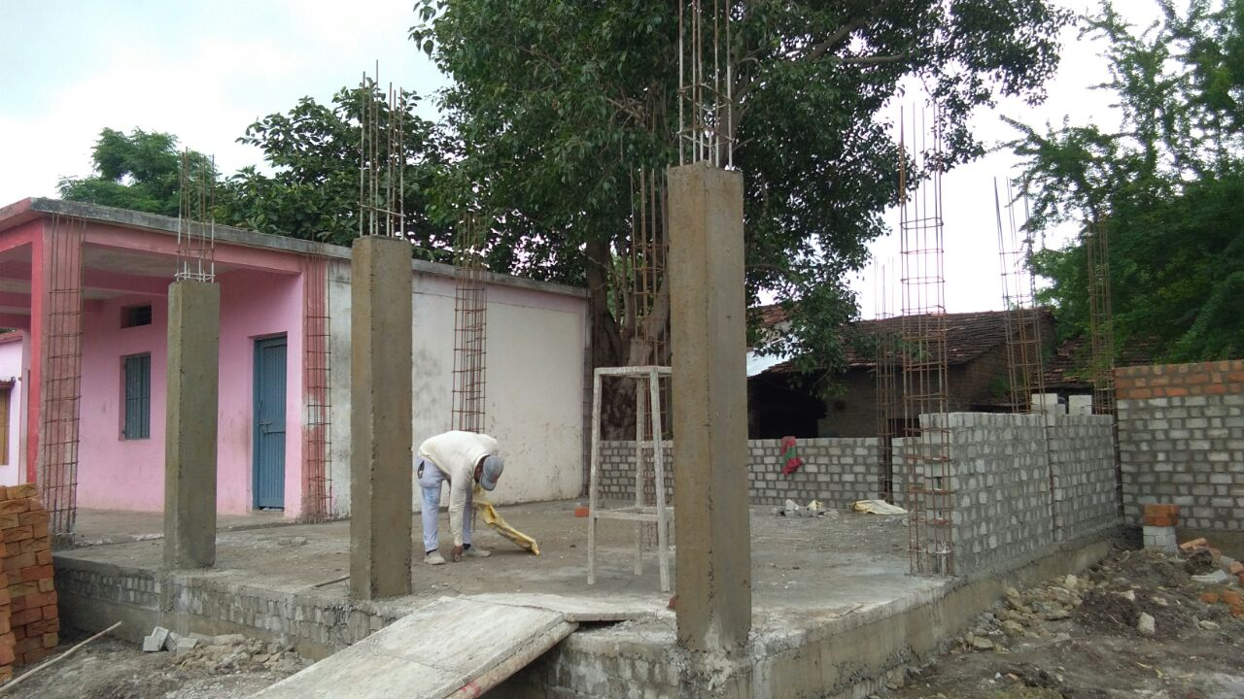
Upgradation of School
No of Villages taken | 10/10
No of Schools covered | 23/26
Activities taken
Boundary Wall | 1792 rm
Extra Class room | 6
Smart Class & Accessories
Smart Class room | 5
Internal Electrification | 5 school
Furniture | 4 school
Total Amount (Rs) | 248.79 Lakh
Work Started | Yes

Slide 10
Upgradation of School
No of Villages taken | 10/10
No of Schools covered | 23/26
Activities taken
Boundary Wall | 1792 rm
Extra Class room | 6
Smart Class & Accessories
Smart Class room | 5
Internal Electrification | 5 school
Furniture | 4 school
Total Amount (Rs) | 248.79 Lakh
Work Started | Yes

Slide 11
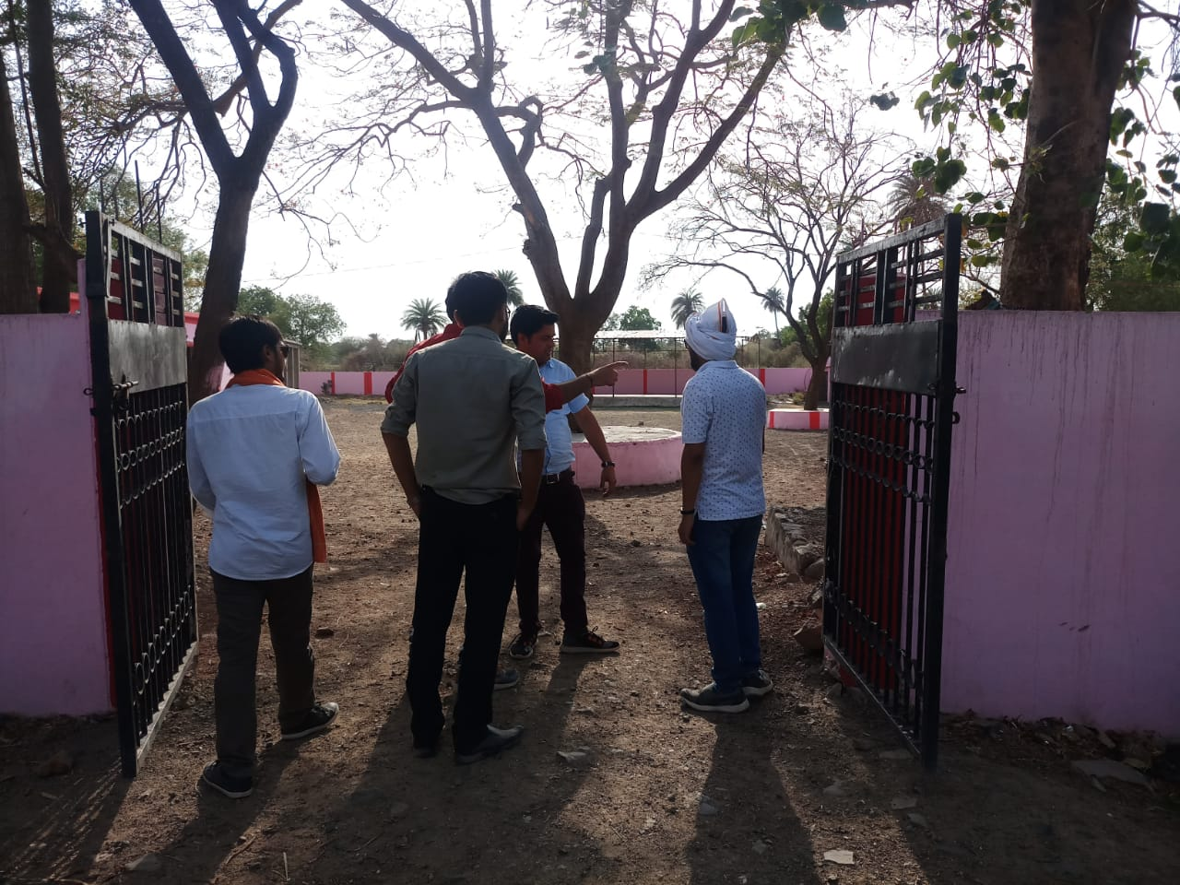
Upgradation of School

Slide 12
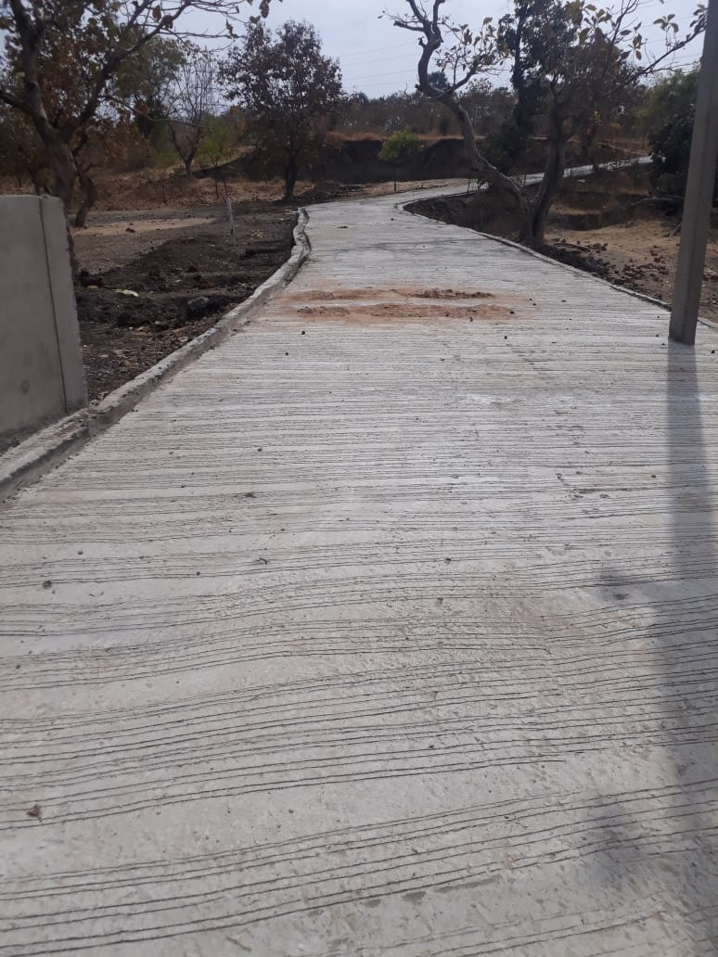
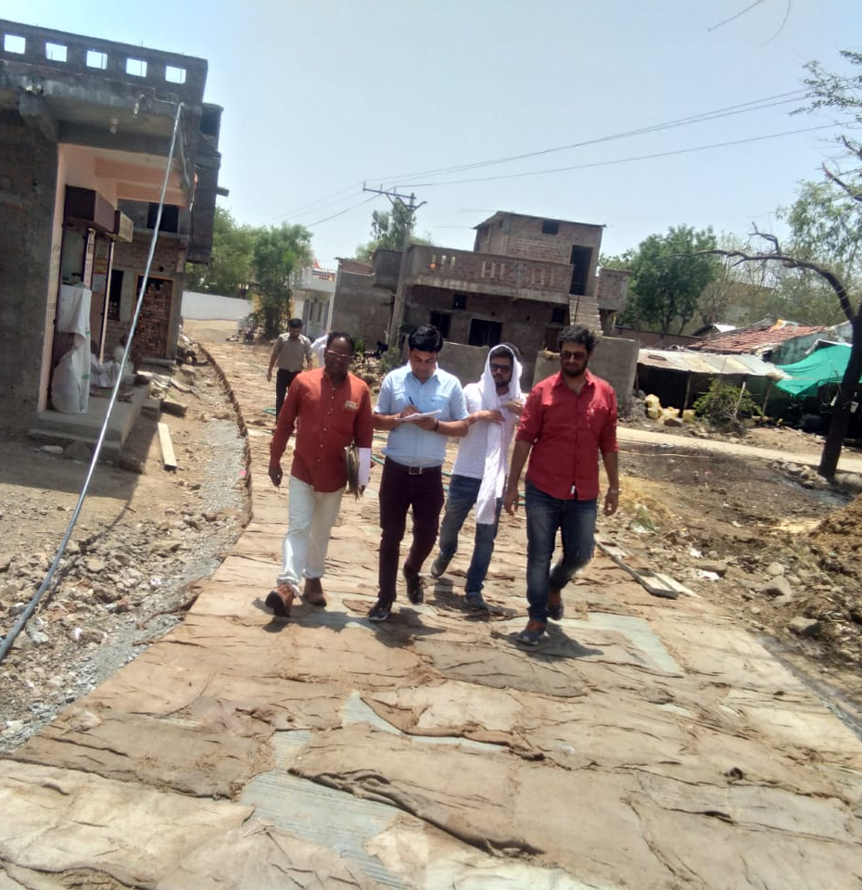
Village Streets with Drains
No of Villages taken | 10/10
Population covered | 30,800
Activities taken
CC roads with Drains | 25
Total Amount (Rs) | 300.16 Lakh
Work Started | Yes
Road Stretches considered under mission work neither fall in Village DPR of 14th finance nor covered by any means of funding like convergence scheme, grant, etc.

Slide 13
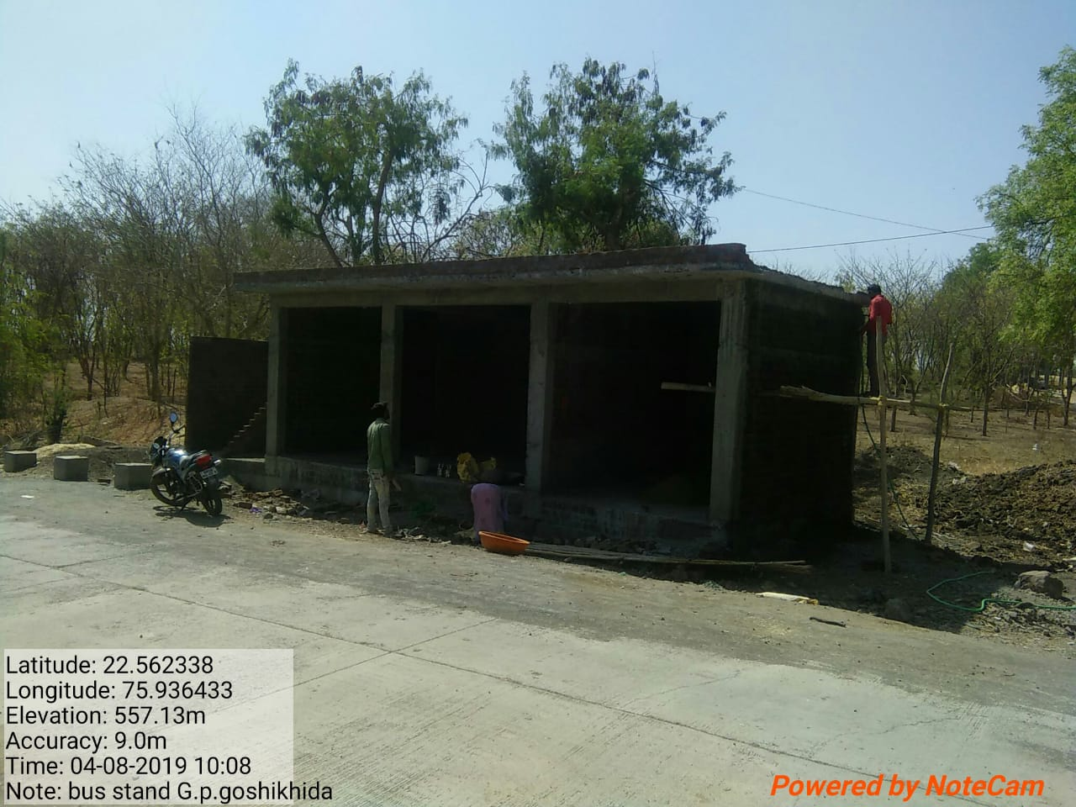
Public Transport
No of Villages taken | 2/10
Population covered | 12,233
Activities taken
Bus Shelter with Shop | 1
Bus shelter with shop and toilets for female | 1
Total Amount (Rs) | .08 cr
Work Started | Yes

Slide 14
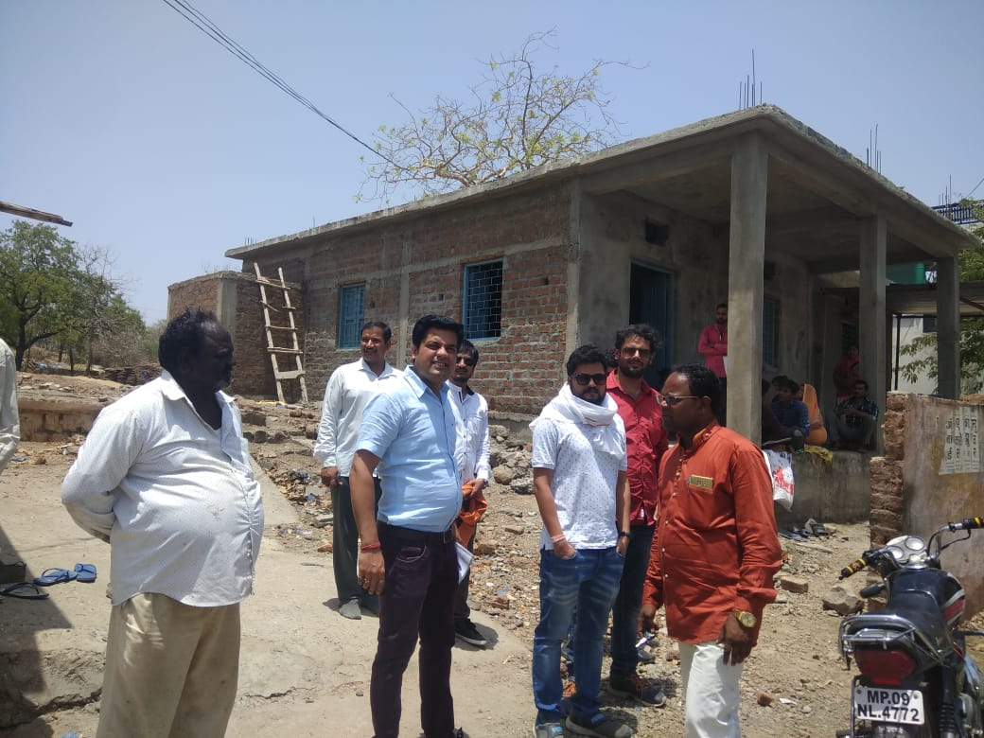
Special Social Infrastructure
No of Villages taken | 7/10
Population covered | 27,248
Activities taken
Community Hall | 6
Anganwadi Boundary wall | 275 rm
Playground | 1
Total Amount (Rs) | 110.25 Lakh
Work Started | Yes

Slide 15
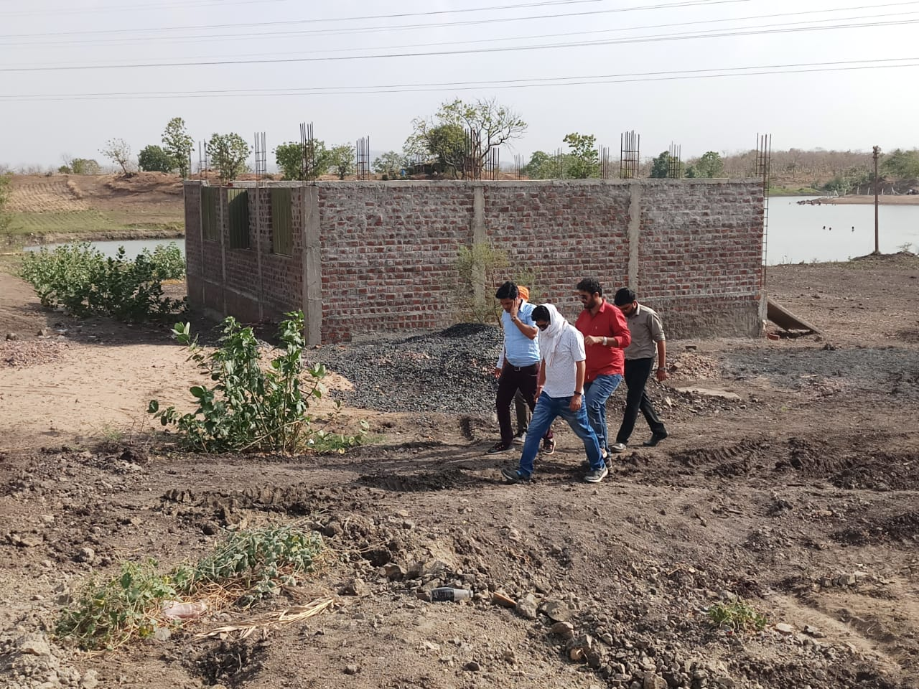
Special Social Infrastructure
No of Villages taken | 7/10
Population covered | 27,248
Activities taken
Community Hall | 6
Anganwadi Boundary wall | 275 rm
Playground | 1
Total Amount (Rs) | 110.25 Lakh
Work Started | Yes

Slide 16

REACTIONS. FROM COMMUNITY

Slide 17
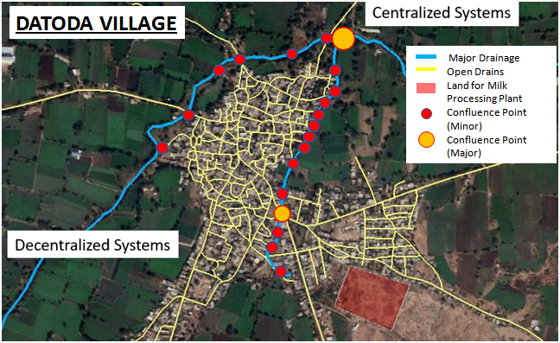
Solid and Liquid Waste Management

Slide 18
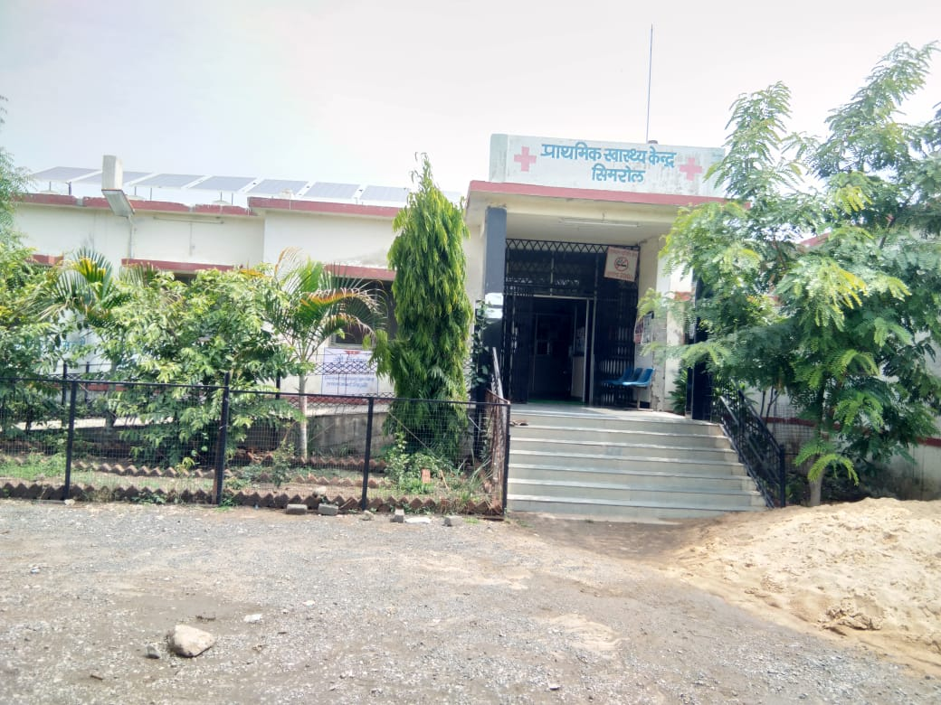
Health
No of Villages taken | 1/10
Population covered | 24264
Activities taken
Boundary wall | 300 rm
Paver Block | 625
Roof water Harvesting System | 1
Waiting hall with toilets | 1
Total Amount (Rs) | 26.76 Lakh
Work Started | No

Slide 19
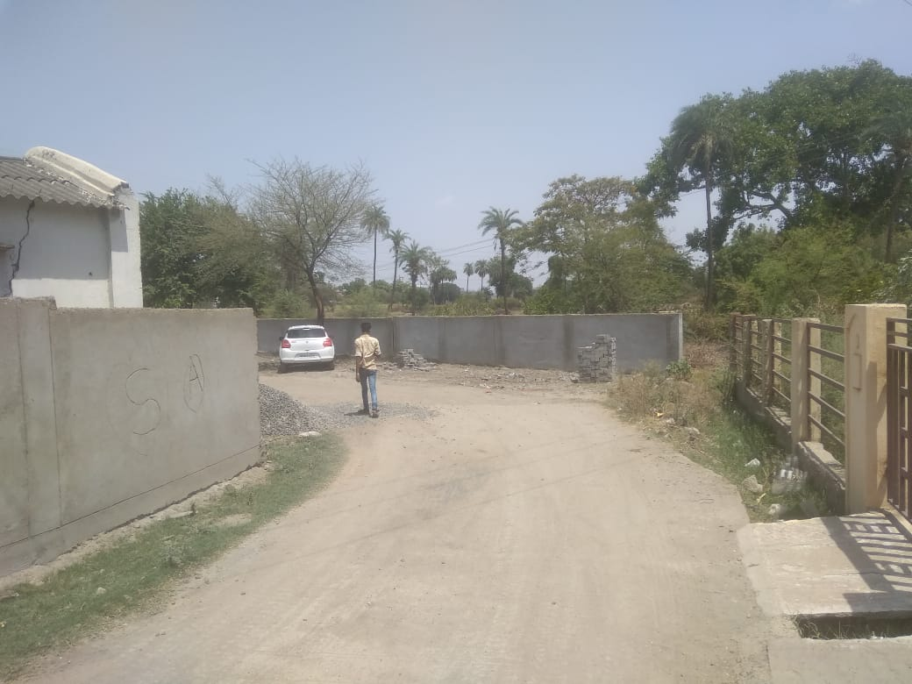
Health
No of Villages taken | 1/10
Population covered | 24264
Activities taken
Boundary wall | 300 rm
Paver Block | 625
Roof water Harvesting System | 1
Waiting hall with toilets | 1
Total Amount (Rs) | 26.76 Lakh
Work Started | No

Slide 20
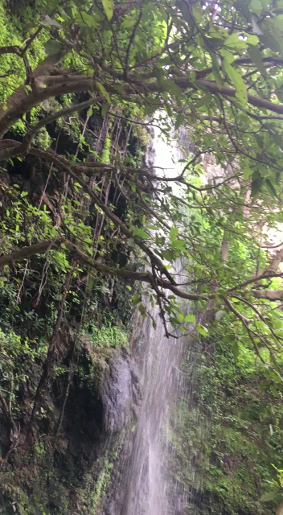
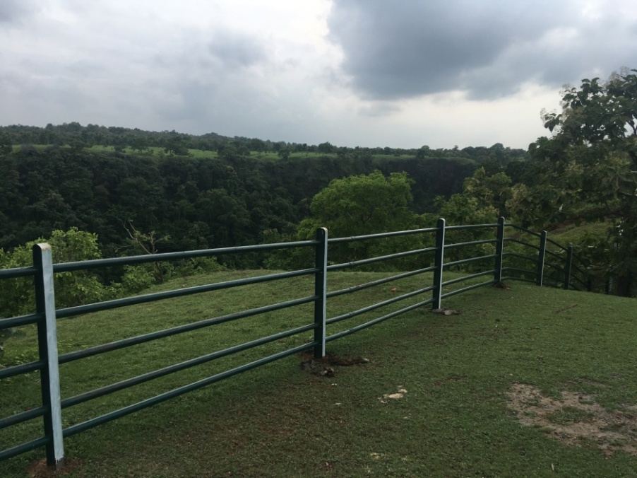
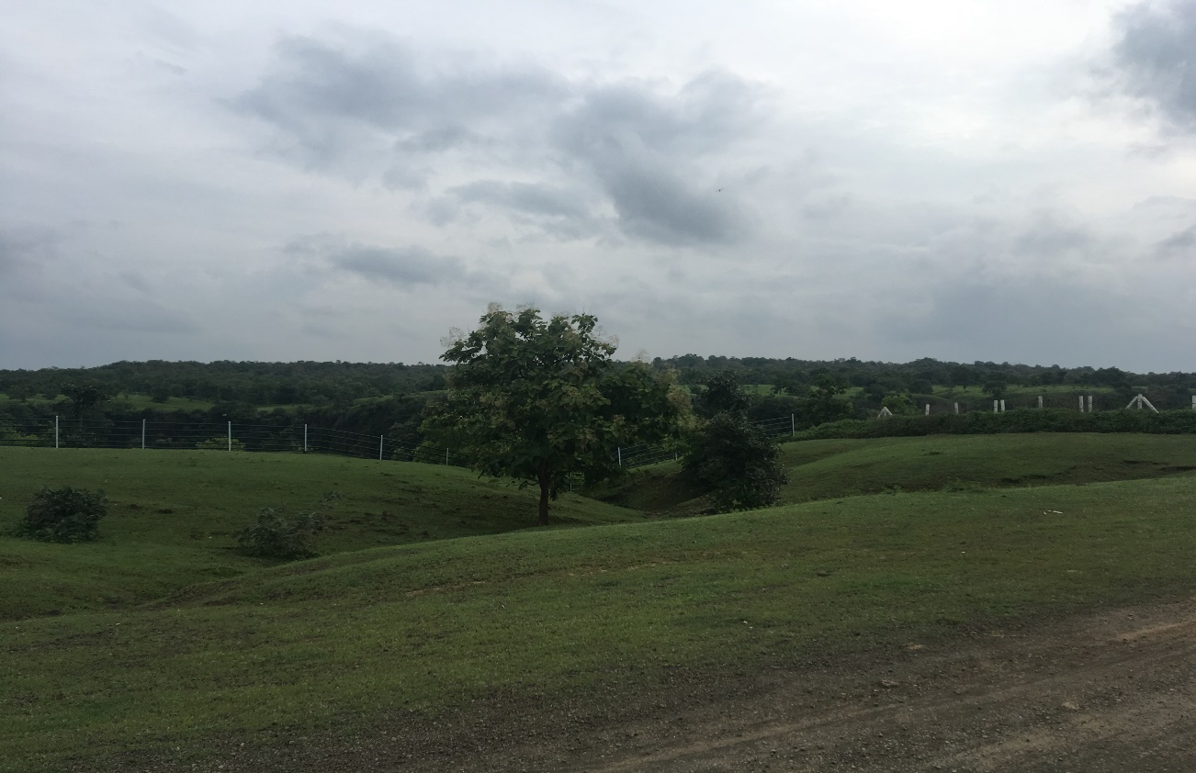
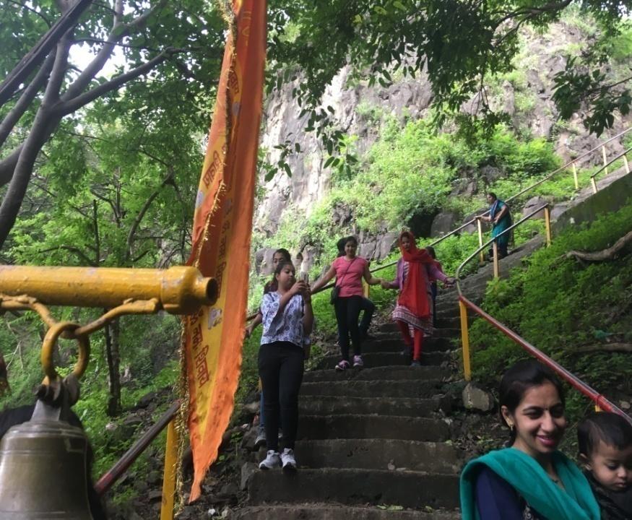
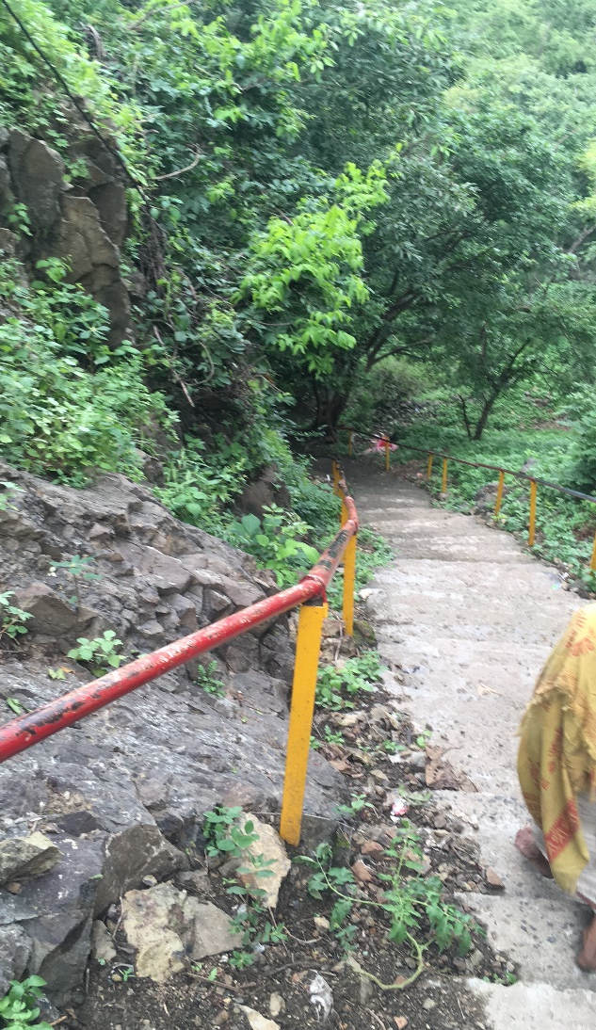
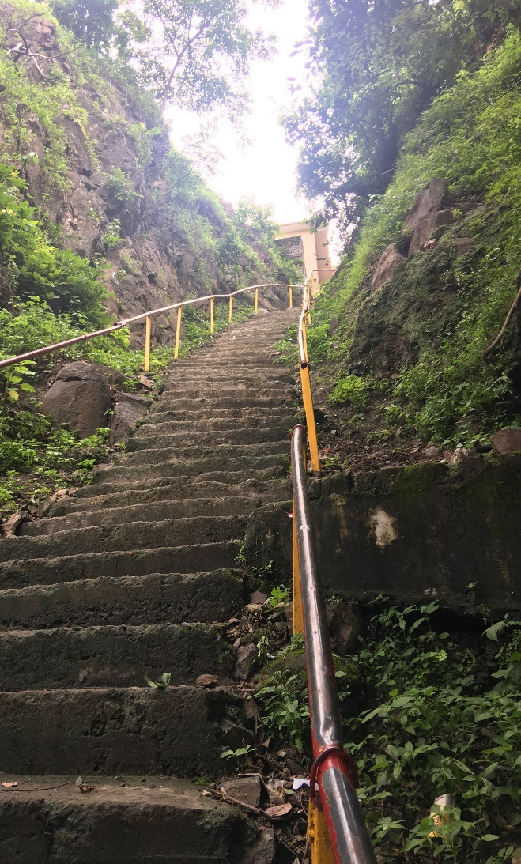
Tourism
Kajaligarh Fort Premise
Video 3, Kajaligarh Waterfall

Slide 21
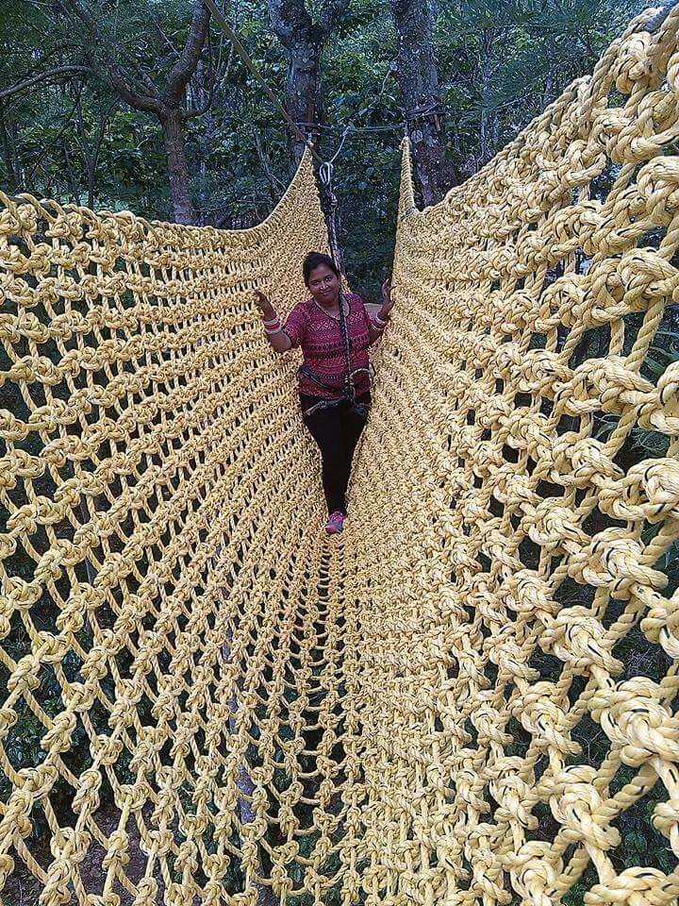
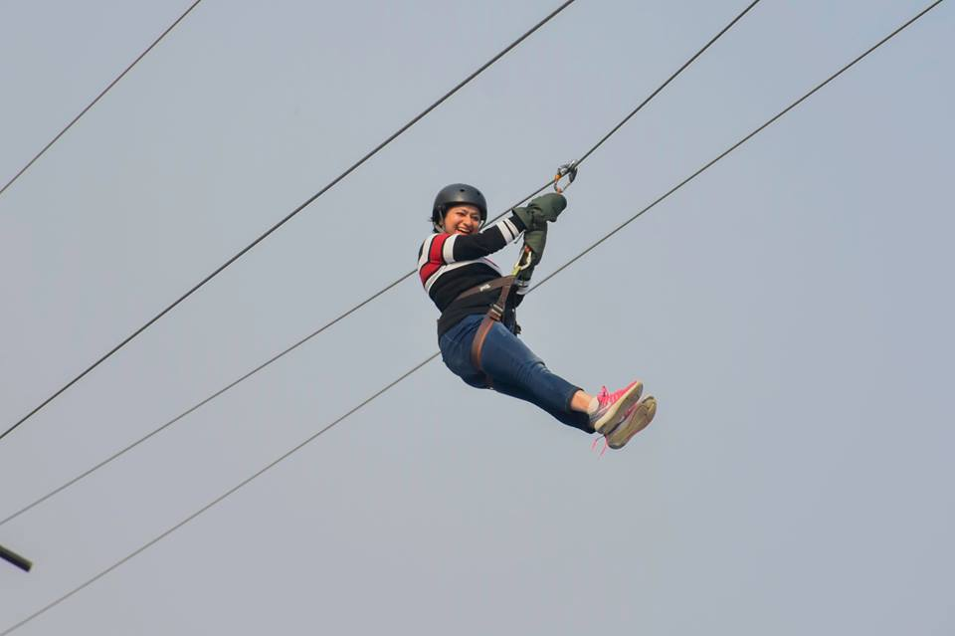
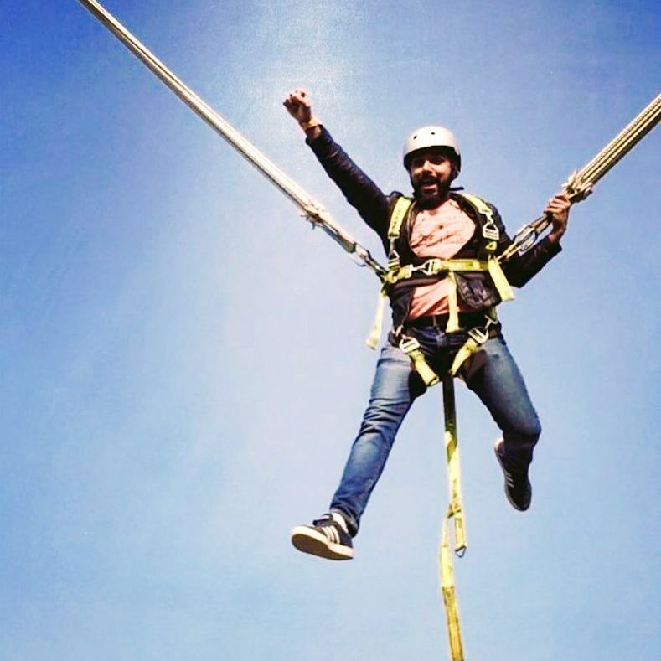
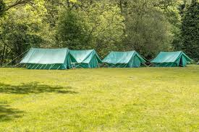
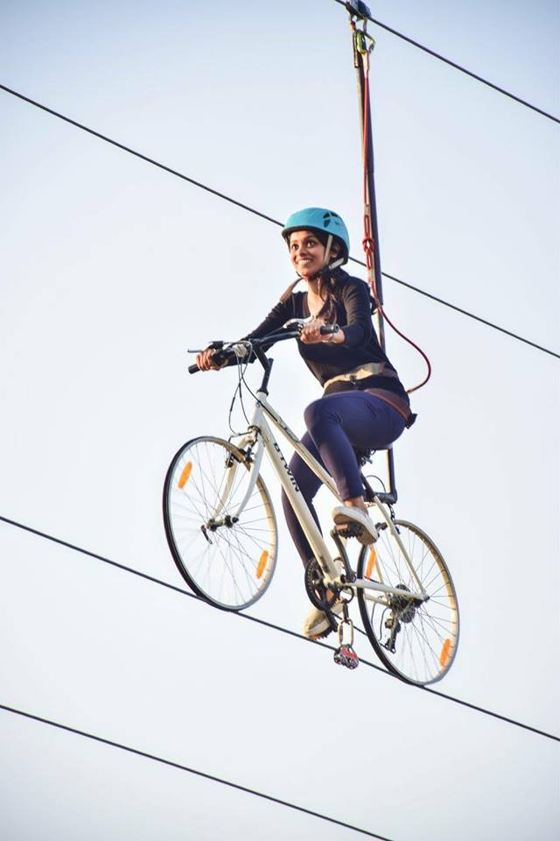
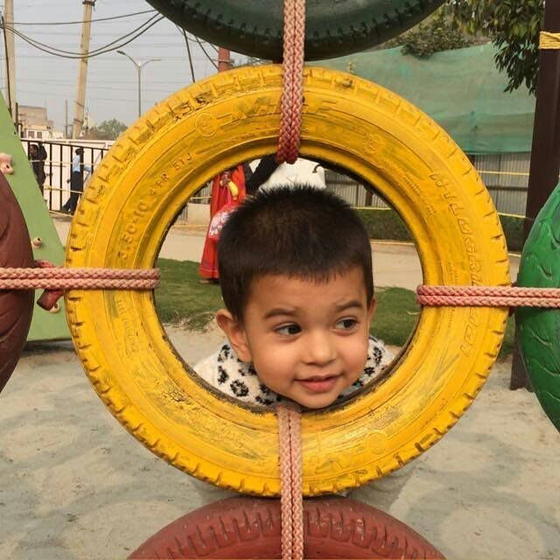
Tourism – Activities Taken
Rope Courses
Zip Lining
Bungee Ejector
Camp Site
Sky Cycle
Kids Rope Activities

Slide 22
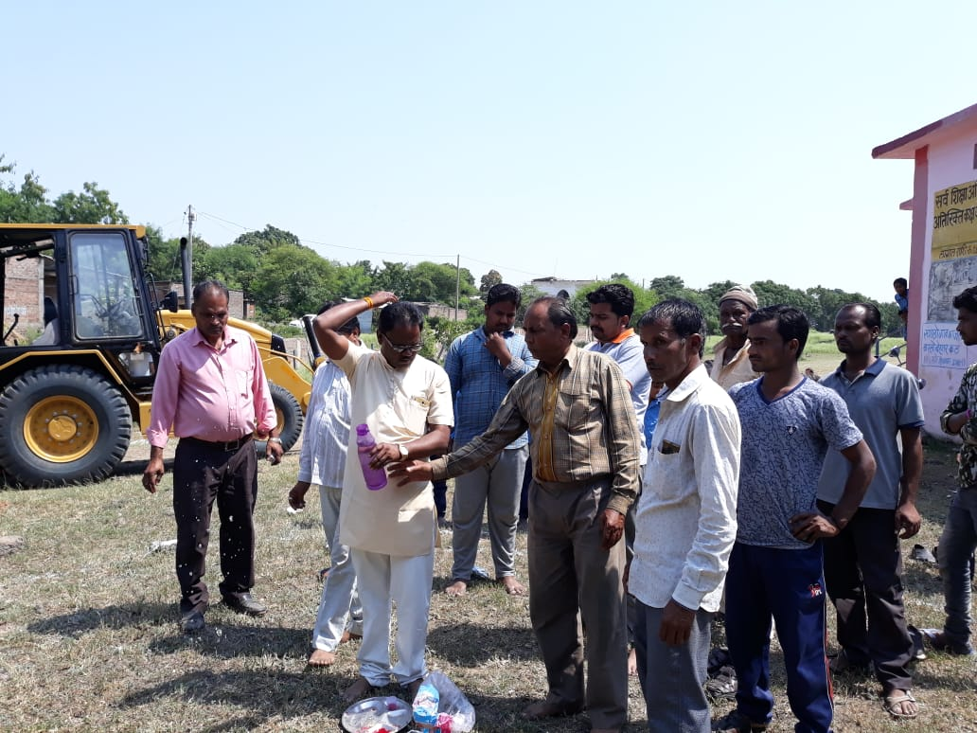
Role of Elected Representative
Seamless speed of works undertaken by PRIs & other agencies.
Easy facilitation of Government land for laying down of Rurban Infrastructure.
Operation & Maintenance strategy for each activity is being conducted .
Ensuring political clearance.

Slide 23
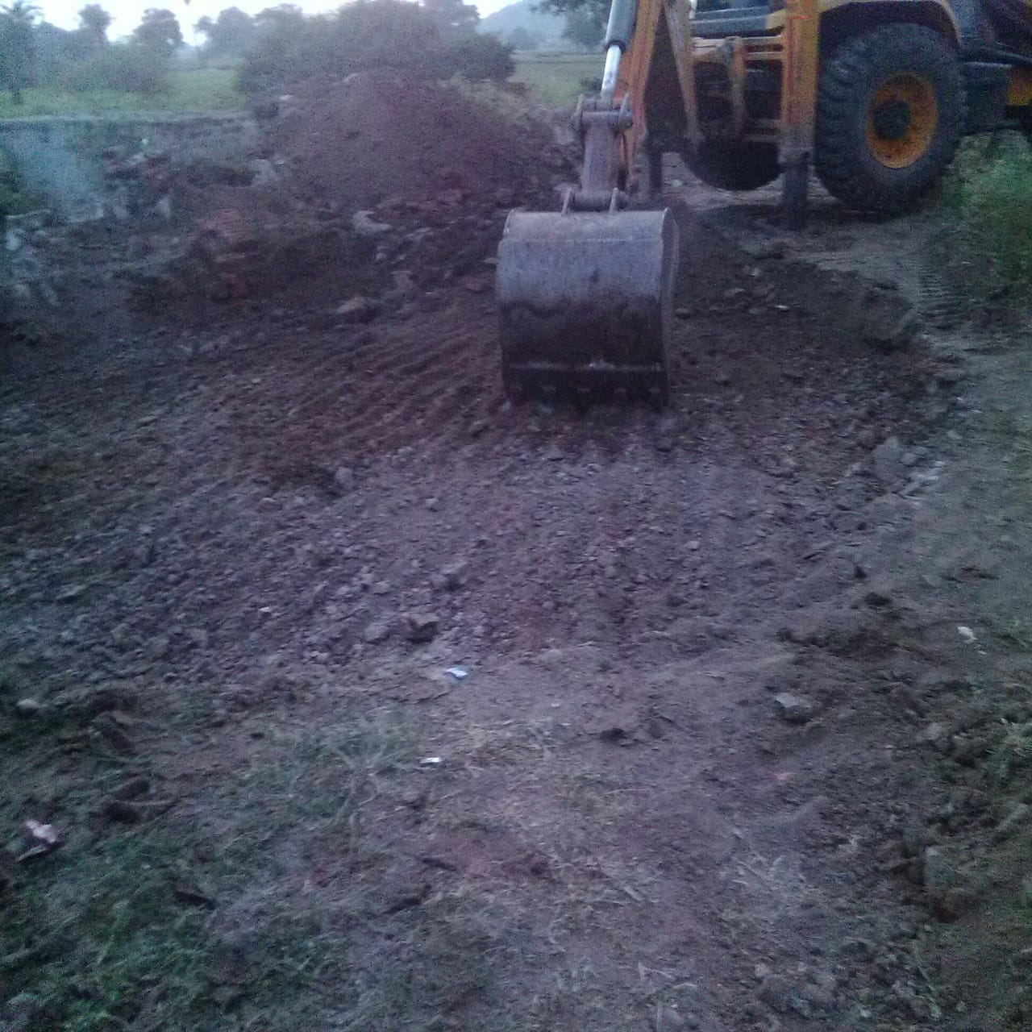
Special Initiative
With no source found within village, 24x7 Water Scheme is successfully connected to Narmada Kshipra link by liasioning NVDA.
The initiative ensures sustainable supply round the year.
Promotion of Adventure Tourism and inclusion of Gram Van Samiti for Livelihood generation , which directly lead to its O & M.

Slide 24
Operation & Maintenance
Head of Committee
Ward Representative
Ward 1
Ward 2
Ward Representative
Ward 3
Gram Panchayat
Committee Members
End User
Rurban component
Concerned Department or Agency
Annual sum suggested by the concerned agency for maintenance
XXX Rs.
XX Rs.
Monthly charges agreed upon by the GP Committee
X Rs.
Formation of committee via a Gram Sabha Proposal
Collection of monthly charges by the ward representatives
Operation and maintenance by the committee

Slide 25
Good Practices
Roof water harvesting and ground water recharge points in all Rurban buildings.
Stop dam construction along with ground water recharge shaft.
Geotagging of all Rurban structures.
Repurposing old pre-fabricated SHC structure as residential quarters.
Strengthening SMCs by incorporating Schools children in the committee to take ownership.
Provision for zero concrete construction in for adventure tourism in Kajligarh forest premise.
Introduction of DEWATS for waste water treatment at village level with Water Aid as Technical partner for Simrol cluster.
Special planning for solid waste management, especially for dry waste by stakeout and co-processing.
Introduction of landscaping and plantation in preparation of estimates for environmental conservation and increasing green cover.
Planning for centralized solar system for contributing in India’s COP21 goal of renewable energy through at cluster level.

Slide 26
THANK YOU

